Slide 1

United Kingdom Cultural Society Analysis
Megan Bailey Komar

Slide 2
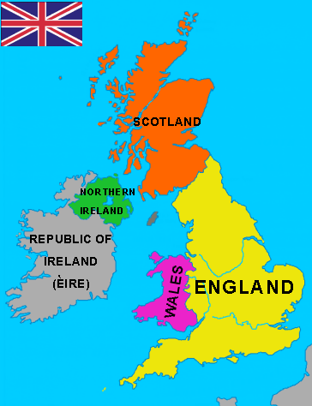
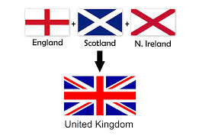
What makes it?
United kingdom of great Britain and northern Ireland

Slide 3
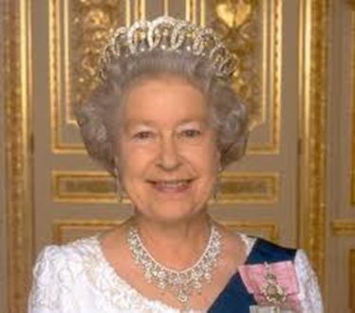
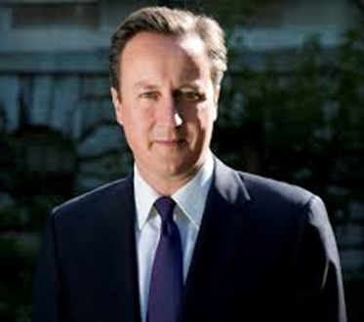
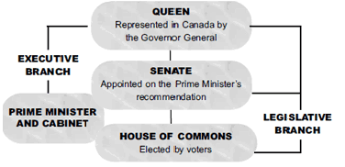
Government Order constitutional monarch
Head of state
Appoints the Prime Minister
Controls the military
Approves all laws
sOversees the government
Appoints the government official
“President” of the government

Slide 4
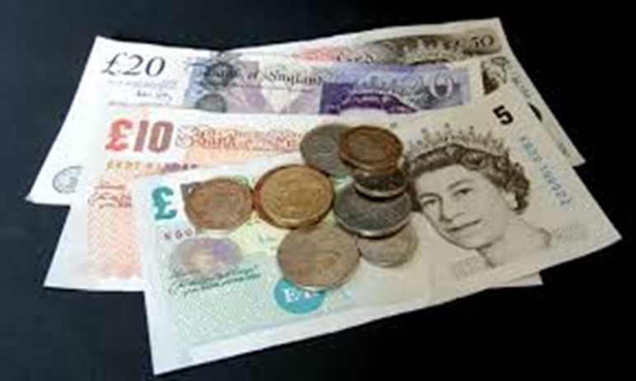
Money!
Pounds
$1 US is worth .66 pounds.
Third Largest Economy in europe

Slide 5
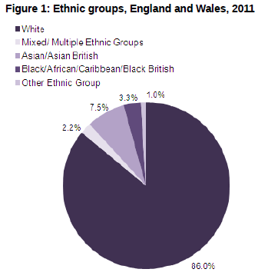
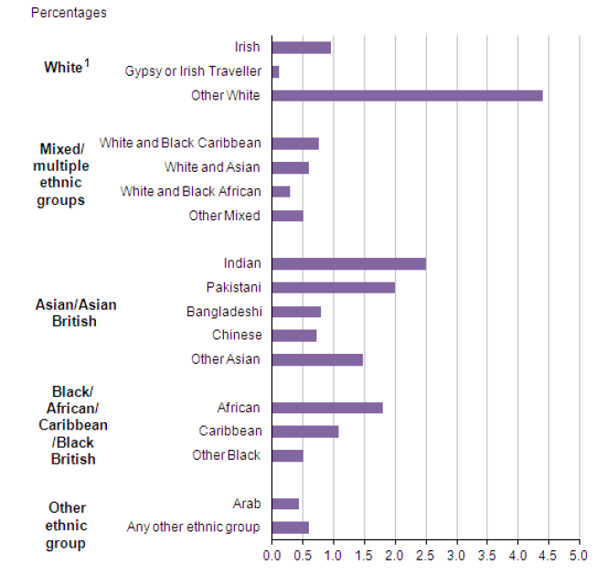
Population
The 2011 UK census estimated the population of the UK to be over 63 million people.

Slide 6
New social class 2013 economic social cultural
Elite - the most privileged group in the UK
Established middle class – Less cultural capital than the elite group
Technical middle class - a small class that is well off but lacks in the areas of social and
New affluent workers – A younger class that is very social and cultural rich with middle of the road economic capital.
Traditional working class – Average age of 66 they are not completely deprived and generally have equity.
Emergent service workers – Yong group with high social and cultural capital
Precariat, or precarious proletariat - scores low for social and cultural capital

Slide 7
Gender Roles and Marriage
50% of females work
Working towards equal pay and occupations
70% of individuals live within one hour of family
1990’s
  National debates
    Education of future generations
    Relationship between
      Work
      Family

Slide 8

Communication/Appearances
English and Welsh
90% speak English
Hello or Shwmae
85% internet access

Slide 9
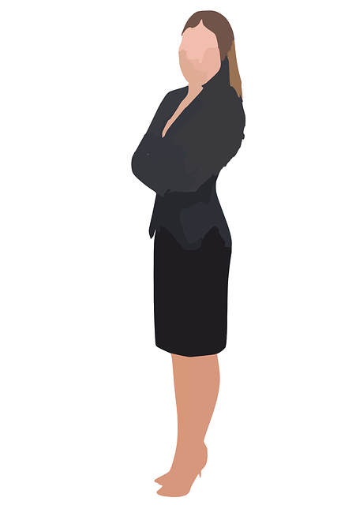
Appearances
“Stiff Upper Lip”
Respect personal space
Shaking hands is acceptable
Unnecessary eye contact
Public emotion unprofessional
Dress to impress
Humor is acceptable
Diplomatic yet transparent

Slide 10
Leadership Style
“The US and UK, by contrast, actually have more hybrid leadership models. US leaders tend to be hard drivers (similar to Indian leaders) and have a much more “ push-oriented” approach to change management. The “rugged individualism” of US culture and our continued struggle to limit the size of government creates a leadership style that focused heavily on execution, with the weight of accountability focused on the individual.” Josh Bersin with Forbes magazine

Slide 11
Traditional transactional to collaborative transformational
Past
  Traditional Leader Model
    Stereotypical
    hierarchical
    Minimal follower input

Slide 12
Collaborative/transformational
Holistic
Diplomatic
Nationally
  United Nations, European Nations, North Atlantic Trade Organization
Modern business models
  Team leadership
  Transparency

Slide 13
Questions?

Slide 14
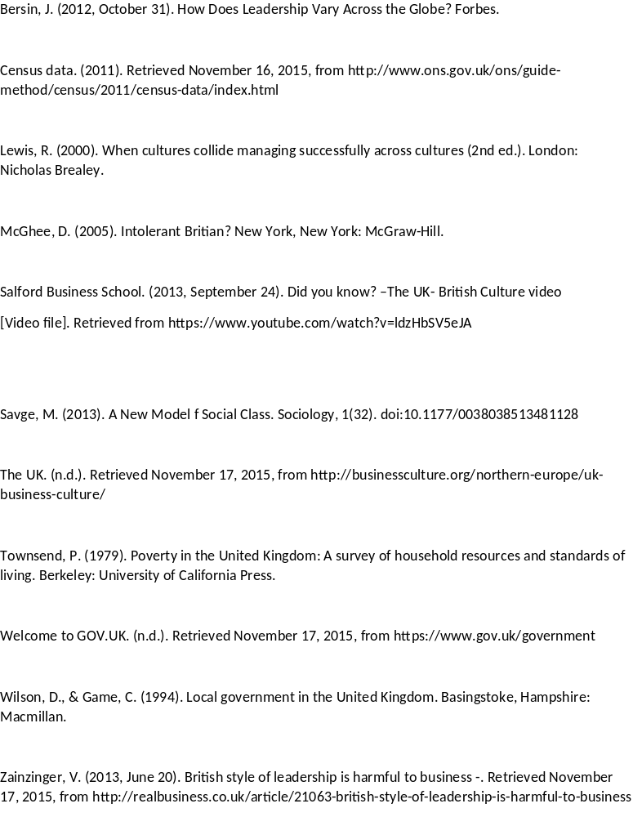
Bibliography

